Slide 1

Networking Rhythm Badge Analysis
Un-Meeting: Machine Learning and Artificial Intelligence Applications in Translational Science
Martin S. Zand, MD, PhD,
CLIC Co-Director
Senior Associate Dean for Clinical Research
University of Rochester Medical Center
The University of Rochester Center for Leading Innovation and Collaboration (CLIC) is the coordinating center for the Clinical and Translational Science Awards (CTSA) Program, funded by the National Center for Advancing Translational Sciences (NCATS) at the National Institutes of Health (NIH), Grant U24TR002260
Notes:
An estimated 2 million Americans are addicted to opioids, with more than 115 citizens dying every day due to overdoses.
It’s clear that science and research will play a critical role in addressing this public health crisis as we look for innovative and alternative solutions to the problems at hand.

Slide 2
What types of meetings BEST lead to lasting scientific collaborations?
Standard versus Un-meetings

Slide 3
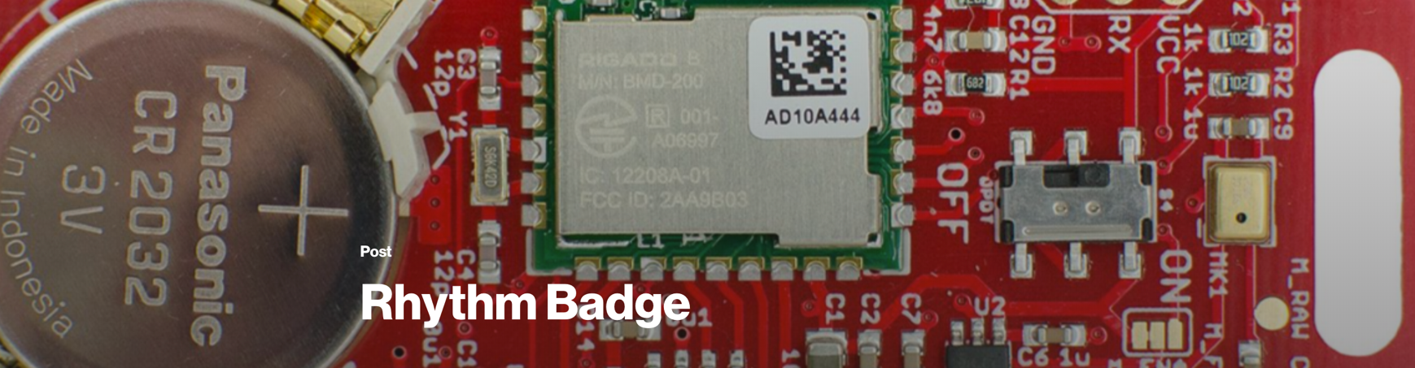
Background
Center for Leading Innovation and Collaboration (CLIC)
Funded by the National Center for Advancing Translational Sciences (NCATS)
Rhythm Badges –
Human Dynamics Group
Expert - Oren Lederman PhD
University of Rochester RSRB STUDY00003597

Slide 4
The “un-agenda”
7:45 AM |  | Registration/Networking/Breakfast
8:30 AM |  | Welcome and Opening Remarks
8:45 AM |  | Framing the Issues: 4 slides x 4 minutes - no mercy (really)
9:05 AM |  | To “The Board” / Idea Generation
9:50 AM |  | Breakout Sessions - 2 x 45 minutes
11:30 AM |  | Lunch/Networking
12:20 PM |  | Framing the Issues: 4 slides x 4 minutes
12:40 PM |  | Idea Generation
1:10 PM |  | Breakout Sessions - 2 x 45 minutes
2:50 PM |  | Closing Remarks

Slide 5
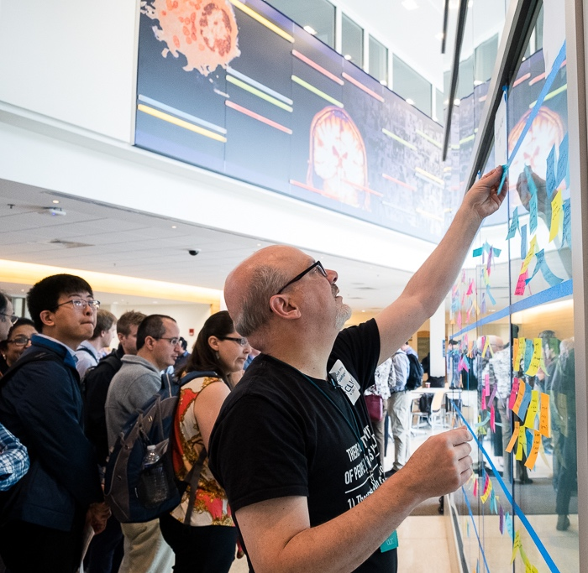
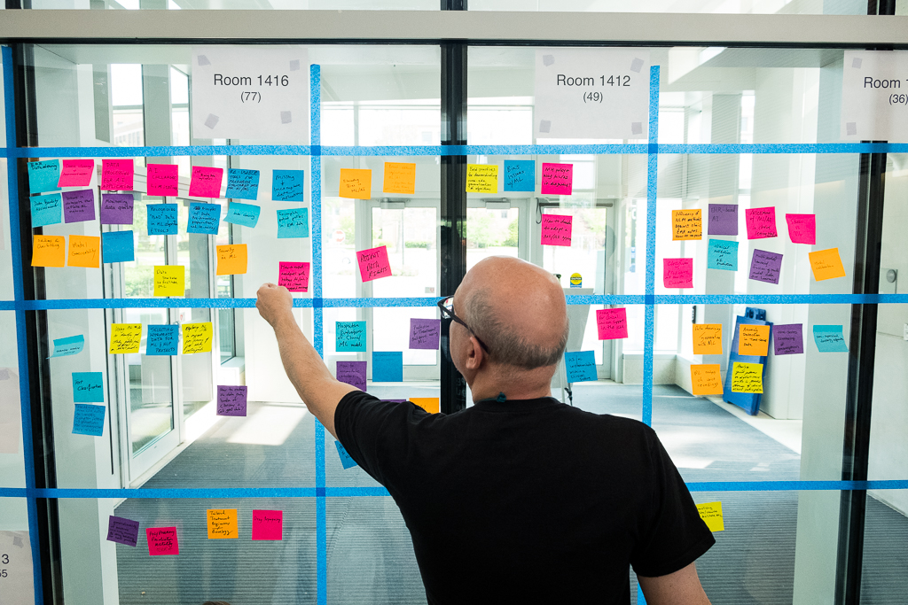
The “un-agenda”

Slide 6
Rhythm / Sociometric Badges
Developed at MIT Media Lab
Wearable Sensor
Distance from other badges
Voice sensor
IR Proximity Sensor

Slide 7
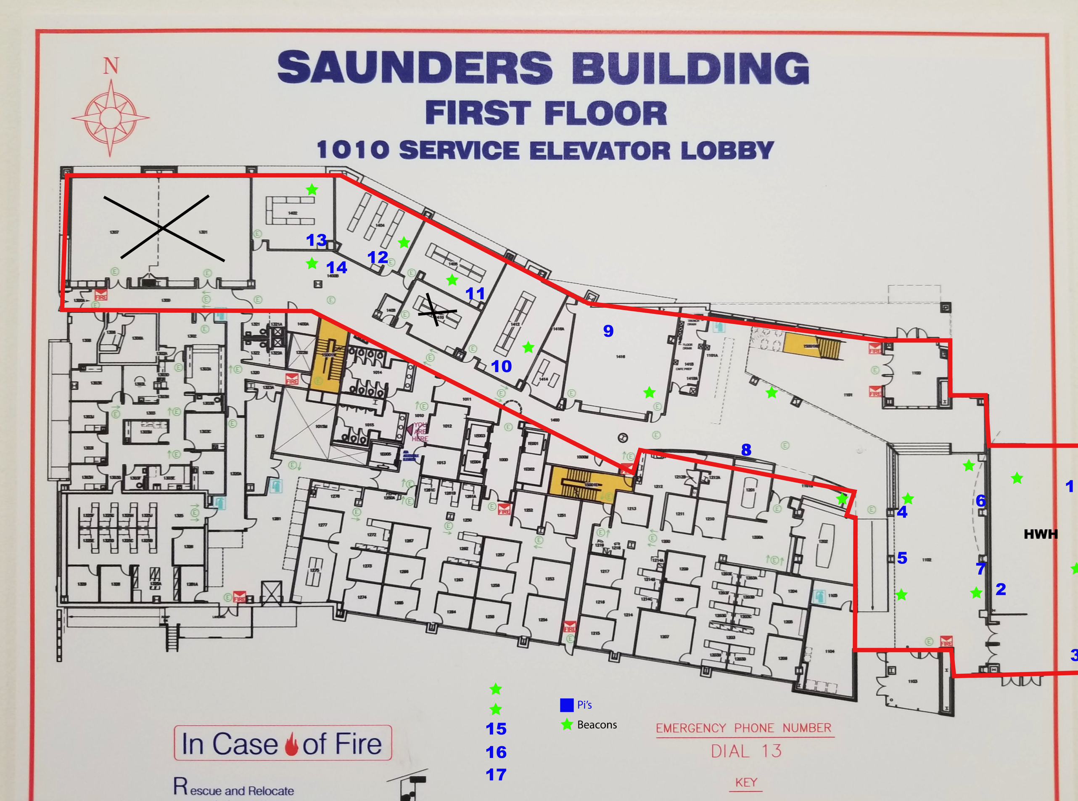
Beacons
Fixed
In conference areas
Overlap?
Coverage Density?
86 attendees’ information recorded on 17 servers

Slide 8
DaTA STRUCTURE
Data collected: the member key of the scanning badge, it's MAC address, timestamp of the scan, voltage at the time of the scan, and a list of other bluetooth devices picked up by the scan.
"timestamp" - scan start time
“observed_id” - observed member id
“count” : x -
“rssi”: - signal strength (distance from member – higher is closer)
"member" - member key generating the data
"member_id" - member id generating the data
“badge_address” - member badge IP address generating the data
"log_timestamp": - scan stop time

Slide 9
DATA STRUCTURE
{"data": {"timestamp": 1559400666.0,
"rssi_distances":
{“observed_id”: {“count” : x, “rssi”: -signal strength}
"112": {"count": 1, "rssi": -84},
"60": {"count": 3, "rssi": -84},
"114": {"count": 2, "rssi": -84},
"62": {"count": 2, "rssi": -79},
"63": {"count": 2, "rssi": -82},
"64": {"count": 2, "rssi": -85},
"110": {"count": 5, "rssi": -83},
"member": "JGMPJZAJJC",
"voltage": 2.84,
"member_id": 19,
"badge_address": "DA:B2:A3:57:13:B3"},
"log_timestamp": 1559400969.704,
"type": "proximity received",
"log_index": -1}

Slide 10
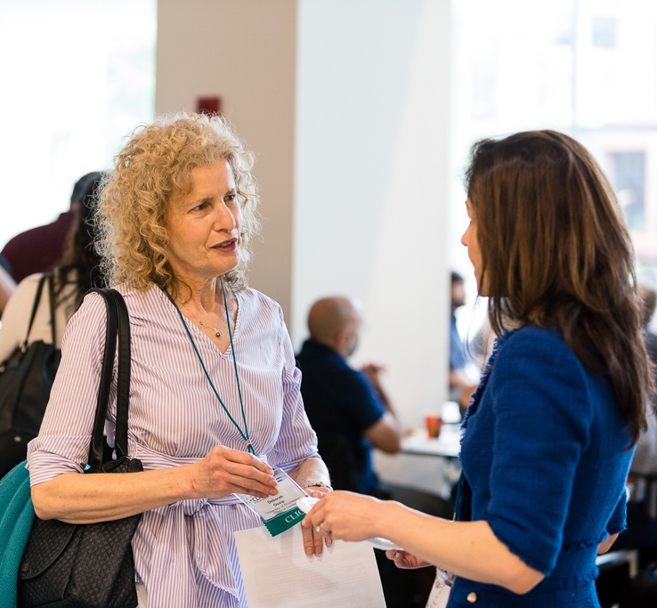
The One Body Problem
What meta-data defines an “interaction”
Proximity
Persistence
Talking
Face-to-face

Slide 11
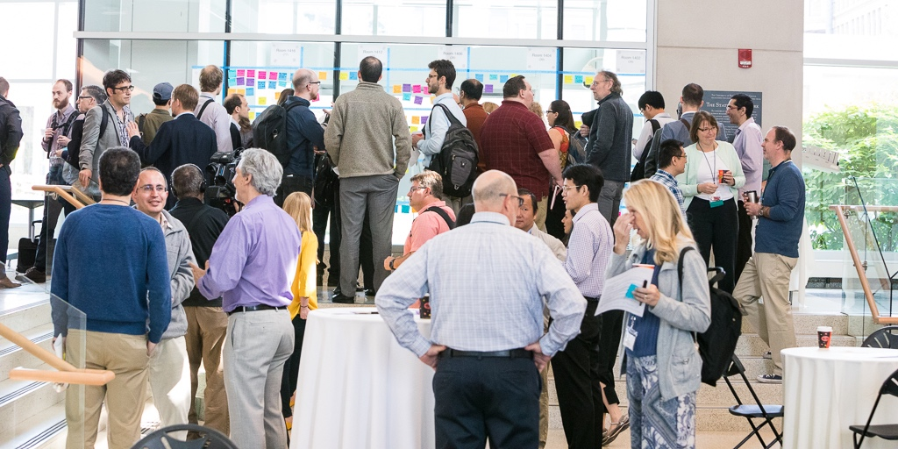
The multi-body problem
Who is interacting with whom?

Slide 12
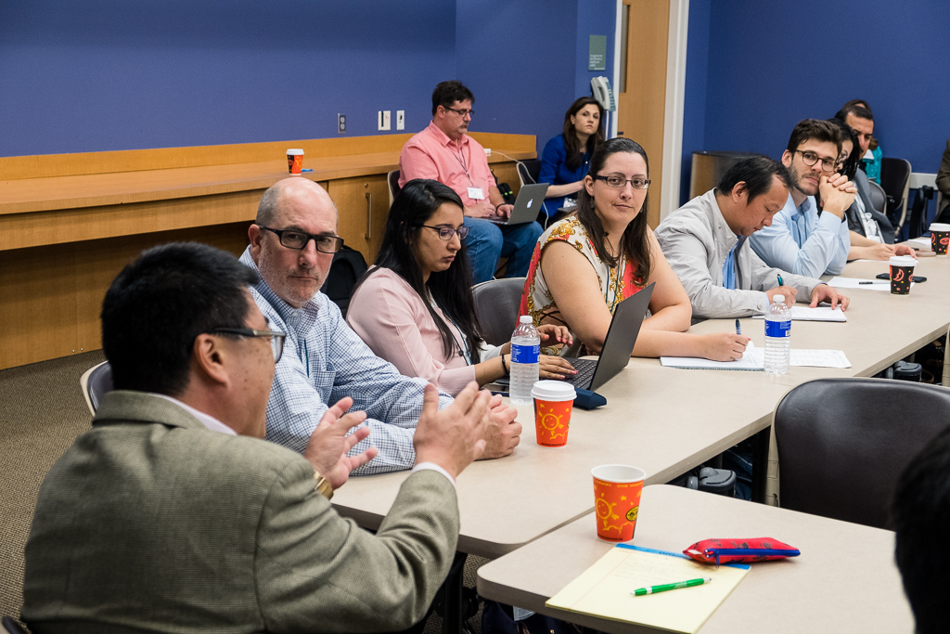
The STATIONARY multi-body problem
Breakout sessions
Proximity is fixed for ~1 hour
Voice sensors

Slide 13
What are (some) of the questions
Transform data into duration
badge read times (duration)
Who interacted with whom
Distribution of attendee proximity and duration
Determine small groups conversing?
Who attended which breakout sessions?
Determine how someone’s field/area of interest (connection to initial survey)
Where they are from (survey data)
Where they went to during the Un-Meeting and what topics were attended

Slide 14
Data
GITHUB https://github.com/HumanDynamics/openbadge-analysis-examples
Information https://groups.google.com/forum/?utm_medium=email&utm_source=footer#!forum/rhythm-badges
PI and Beacon addresses https://rochester.app.box.com/file/467034320668
CLIC Data
https://rochester.box.com/s/qczzutsvlpehjuodrmzrqiupcssuns28
Attendee information - link

Slide 15
Addn’l Resources
https://www.media.mit.edu/posts/rhythm-badge/
Lederman O, Calacci D, MacMullen A, Fehder DC, Murray FE, Sandy'Pentland A. Open Badges: A Low-Cost Toolkit for Measuring Team Communication and Dynamics. arXiv preprint arXiv:1710.01842. 2017.
https://github.com/HumanDynamics/openbadge-analysis-examples
https://github.com/HumanDynamics/openbadge-analysis-examples/commit/a7d5e097e22bb94e52b28e21c4d4976d740b1fd5
https://github.com/HumanDynamics/openbadge-analysis-examples/blob/master/notebooks/hub_proximity_example.ipynb

Slide 16
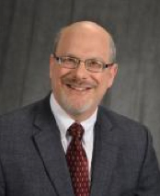
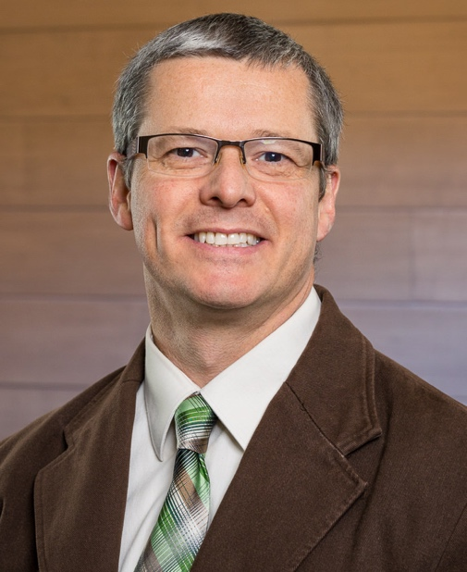
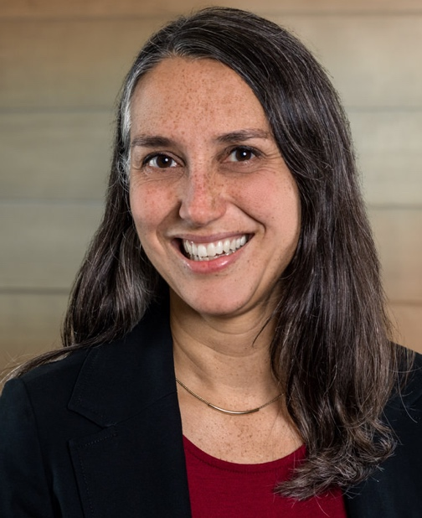
Questions
Martin S. Zand, MD, PhD,
CLIC Co-Director
martin_zand@urmc.rochester.edu
Robert White, MS,
CLIC Associate Director
robertj_white@urmc.rochester.edu
Laura Sugarwala, MBA, RDN
CLIC Sr. Engagement Manager
laura_sugarwala@urmc.rochester.edu

